Slide 1
IE251 Spring 2024 Tecnomatix Plant Simulation Solutions In-Class Exercises
Lennard Heuer, Ph.D. Candidate
KAIST Department of Data Science
lennard.heuer@kaist.ac.kr

Slide 2
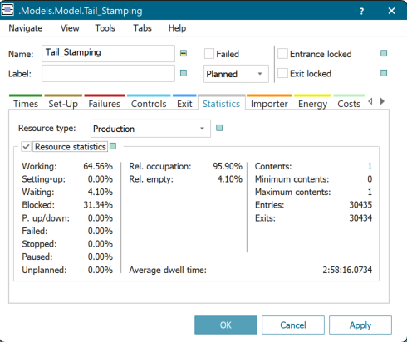
Task 1 – Warm up (Monday)
Solution
 | TH | CT
WIP = 1, Buffer existing | 0.1247 | 8.017
WIP = 1, Buffer removed | 0.1249 | 8.0044
WIP = 8, Buffer existing | 0.3638 | 21.9892
WIP = 8, Buffer removed | 0.3226 | 24.7921
Removing the buffer leads to the station Tail Stamping sometimes blocking the station Rimming and Rimming sometimes starving Tail Stamping. A part will only be released from the station Tail Stamping when the station Rimming is no longer busy. On the other hand, the station Rimming can only work if there is supply coming from Tail Stamping, which is not ensured. Therefore, having no buffer between Tail Stamping and Rimming prevents a balancing of variability of these two stations and so it increases TH and decreases CT (if WIP is constant). However, this does only take significant effect, when the WIP is sufficiently large (e.g. in the case of WIP = 8). In the case of WIP = 1, a buffer is not needed, since the part can move along the workstations without waiting, while its CT is the accumulated processing times of the workstations.

Slide 3

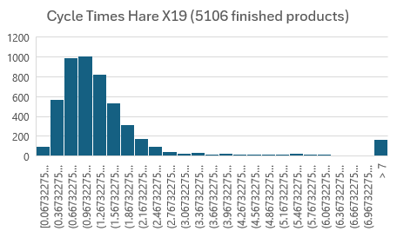
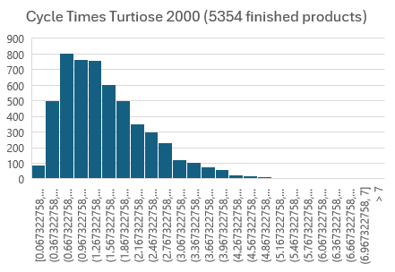
Task 4 - Hare X19 vs. Tortoise 2000 (Wednesday)
Solution
a)
$$\begin{matrix}A_{\text{Hare} \text{X}\text{19} }=\frac{MTTF}{MTTF+MTTR}=\frac{744 Min.}{744 Min.+248 Min.} \\ A_{\text{Hare} \text{X}\text{19} }=\frac{744 Min.}{992 Min.}≈0.75 \\ A_{\text{Tortoise} 2000}=\frac{MTTF}{MTTF+ \text{MTTR} }=\frac{114 Min.}{114 Min.+38 Min.} \\ A_{\text{Tortoise} 2000}=\frac{114 Min.}{152 Min.}≈0.75\end{matrix}$$
b)

Slide 4
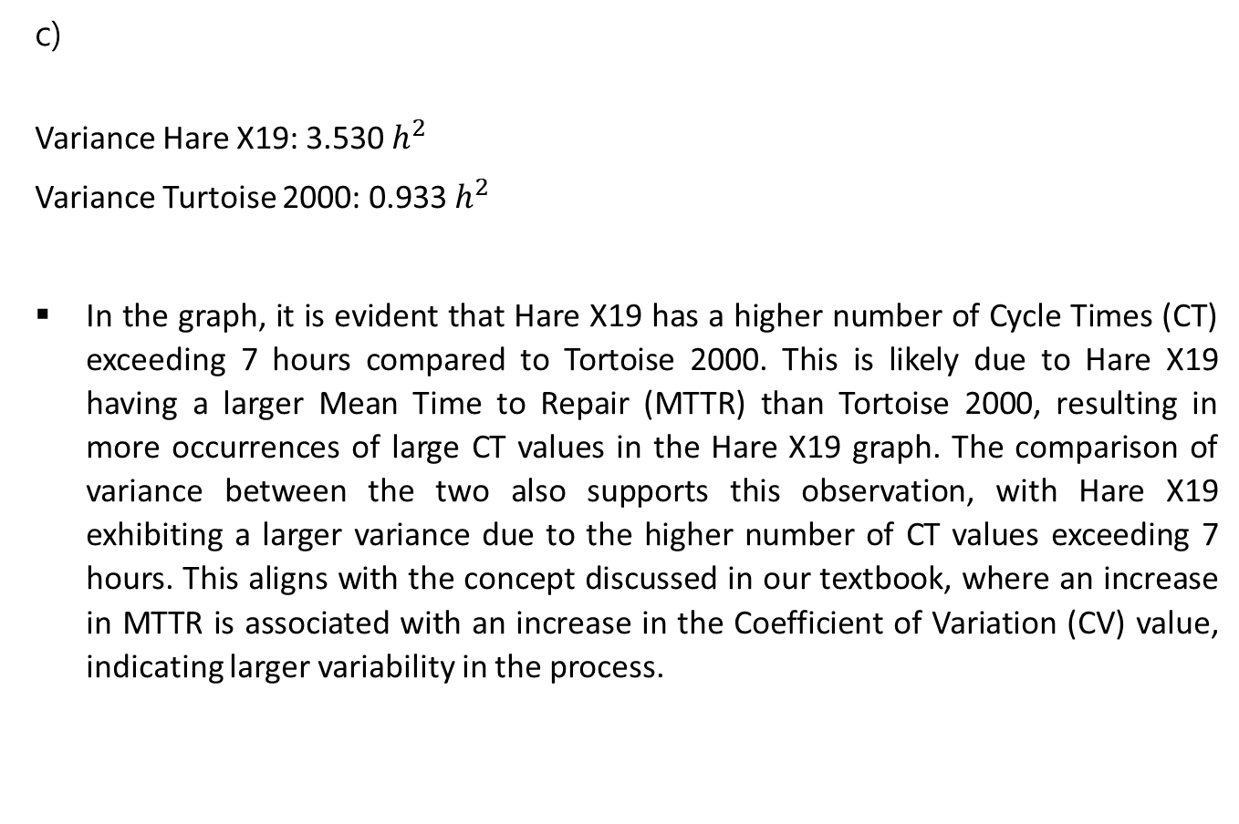
Task 4 - Hare X19 vs. Tortoise 2000 (Wednesday)
Solution
c)
Variance Hare X19: 3.530 $h^{2}$
Variance Turtoise 2000: 0.933 $h^{2}$
In the graph, it is evident that Hare X19 has a higher number of Cycle Times (CT) exceeding 7 hours compared to Tortoise 2000. This is likely due to Hare X19 having a larger Mean Time to Repair (MTTR) than Tortoise 2000, resulting in more occurrences of large CT values in the Hare X19 graph. The comparison of variance between the two also supports this observation, with Hare X19 exhibiting a larger variance due to the higher number of CT values exceeding 7 hours. This aligns with the concept discussed in our textbook, where an increase in MTTR is associated with an increase in the Coefficient of Variation (CV) value, indicating larger variability in the process.

